Slide 1
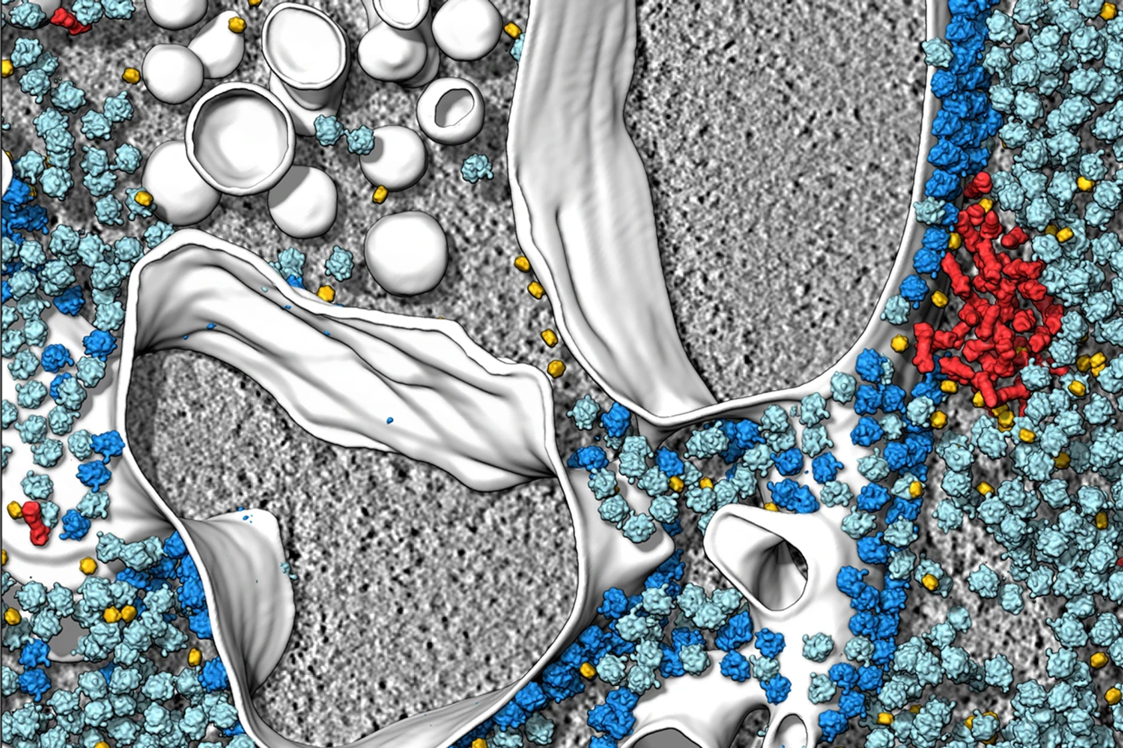
Cryo-et OBJECT IDENTIFICATION
Isaac Fonseca, Elena Gehle, Cody Lerch, Debasis Pradhan, Warren Simons
Cryo-electron tomography and related techniques can showcase the insides of cells in striking detail. Credit: S. Albert et al./PNAS (CC BY 4.0)

Slide 2
Agenda Cryo-ET-Object Identification
Introduction
Data Preparation and Exploration
Data Transformation and YOLO Model Integration
Model Train
Testing and Evaluation
Conclusion
Cryo-electron tomography and related techniques can showcase the insides of cells in striking detail. Credit: S. Albert et al./PNAS (CC BY 4.0)

Slide 3
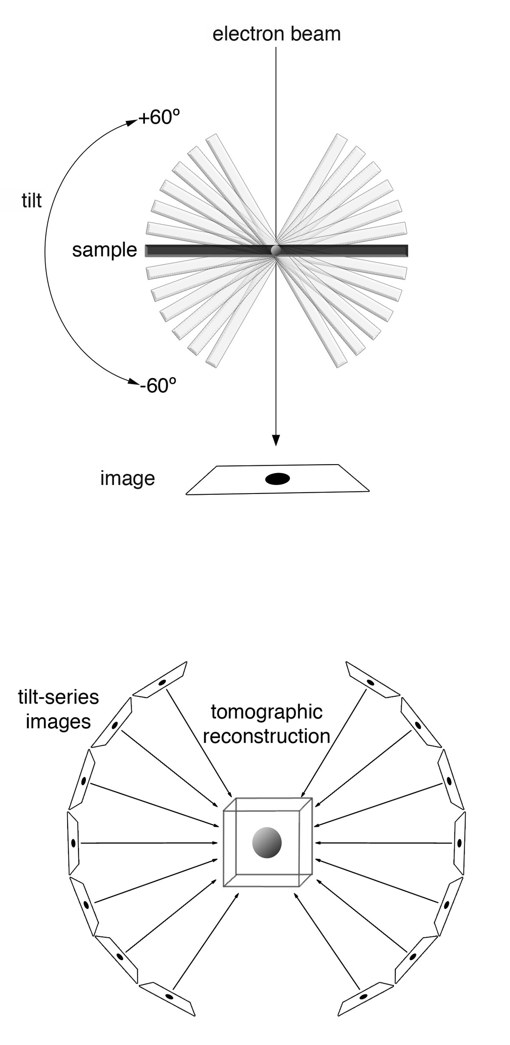
What is CRYO-ET?
Cryo-ET, or Cryo-electron tomography, is an incredibly useful tool in cellular imaging. It provides three-dimensional structural information about individual proteins and particles, as well as information about their spatial arrangement within a cell. Samples are rapidly frozen, cut to an appropriate thickness, and then imaged from different angles using an electron microscope, resulting in a set of 2D projections. Then these images are aligned and merged using advanced computational algorithms to reconstruct a 3D model, or tomogram, of the sample.

Slide 4
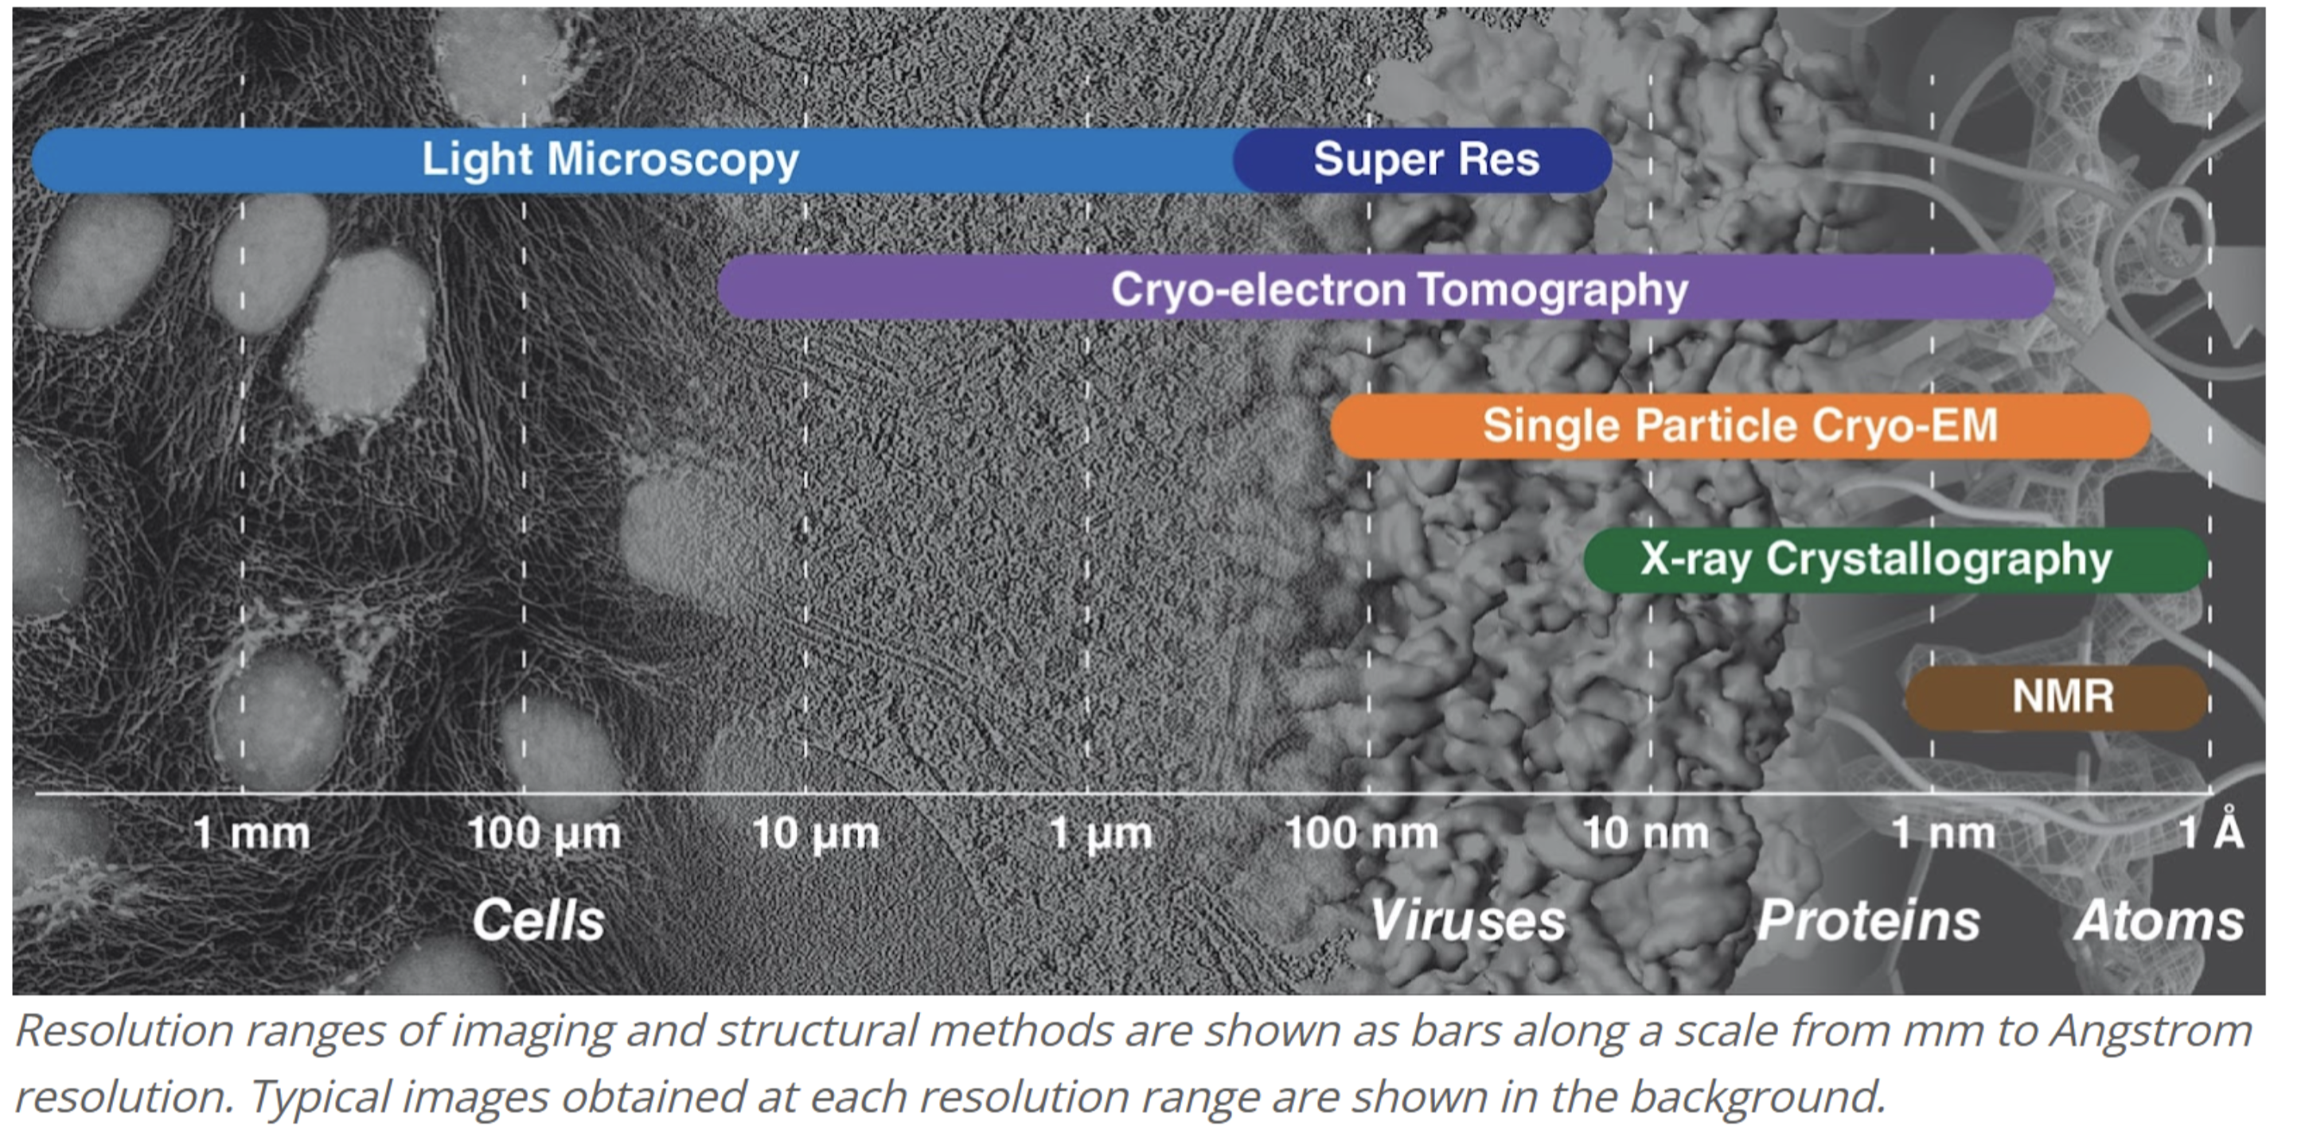
Comparison to other imaging techniques

Slide 5
Particles of interest
Currently, there’s a plethora of Cryo-ET tomograms that have yet to be fully mined. To mine the data involves automatically identifying each protein particle within the images, a problem that has yet to be fully solved. In this project, we seek to use ML algorithms to classify 5 classes of protein complexes from a curated Cryo-ET dataset sourced from Kaggle. The 5 particles of interest are as follows:
Ribosome (easy)
Virus-like particles (easy)
Apo-ferritin (easy)
Thyroglobulin (hard)
ꞵ-galactosidase (hard)

Slide 6
YOLO Model
Sponsor by martin

Slide 7
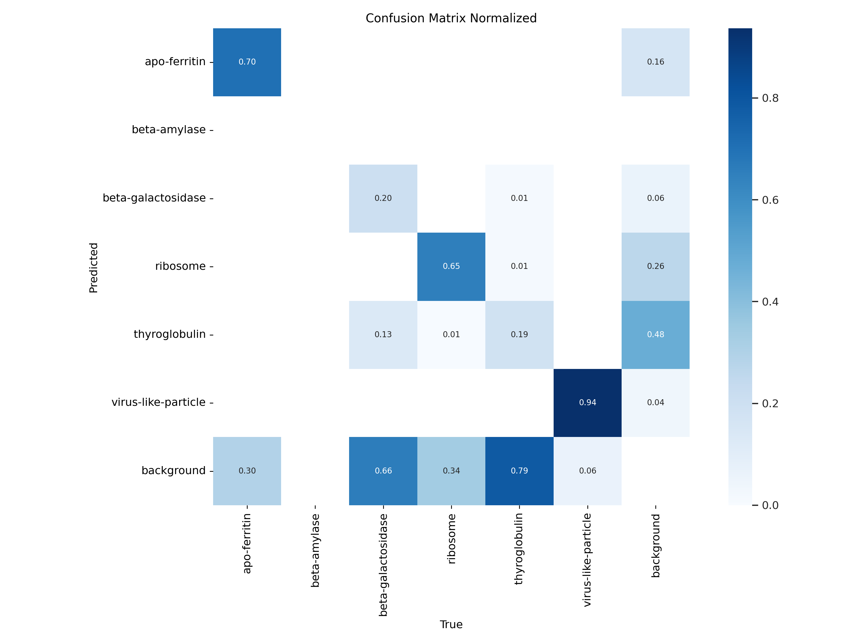
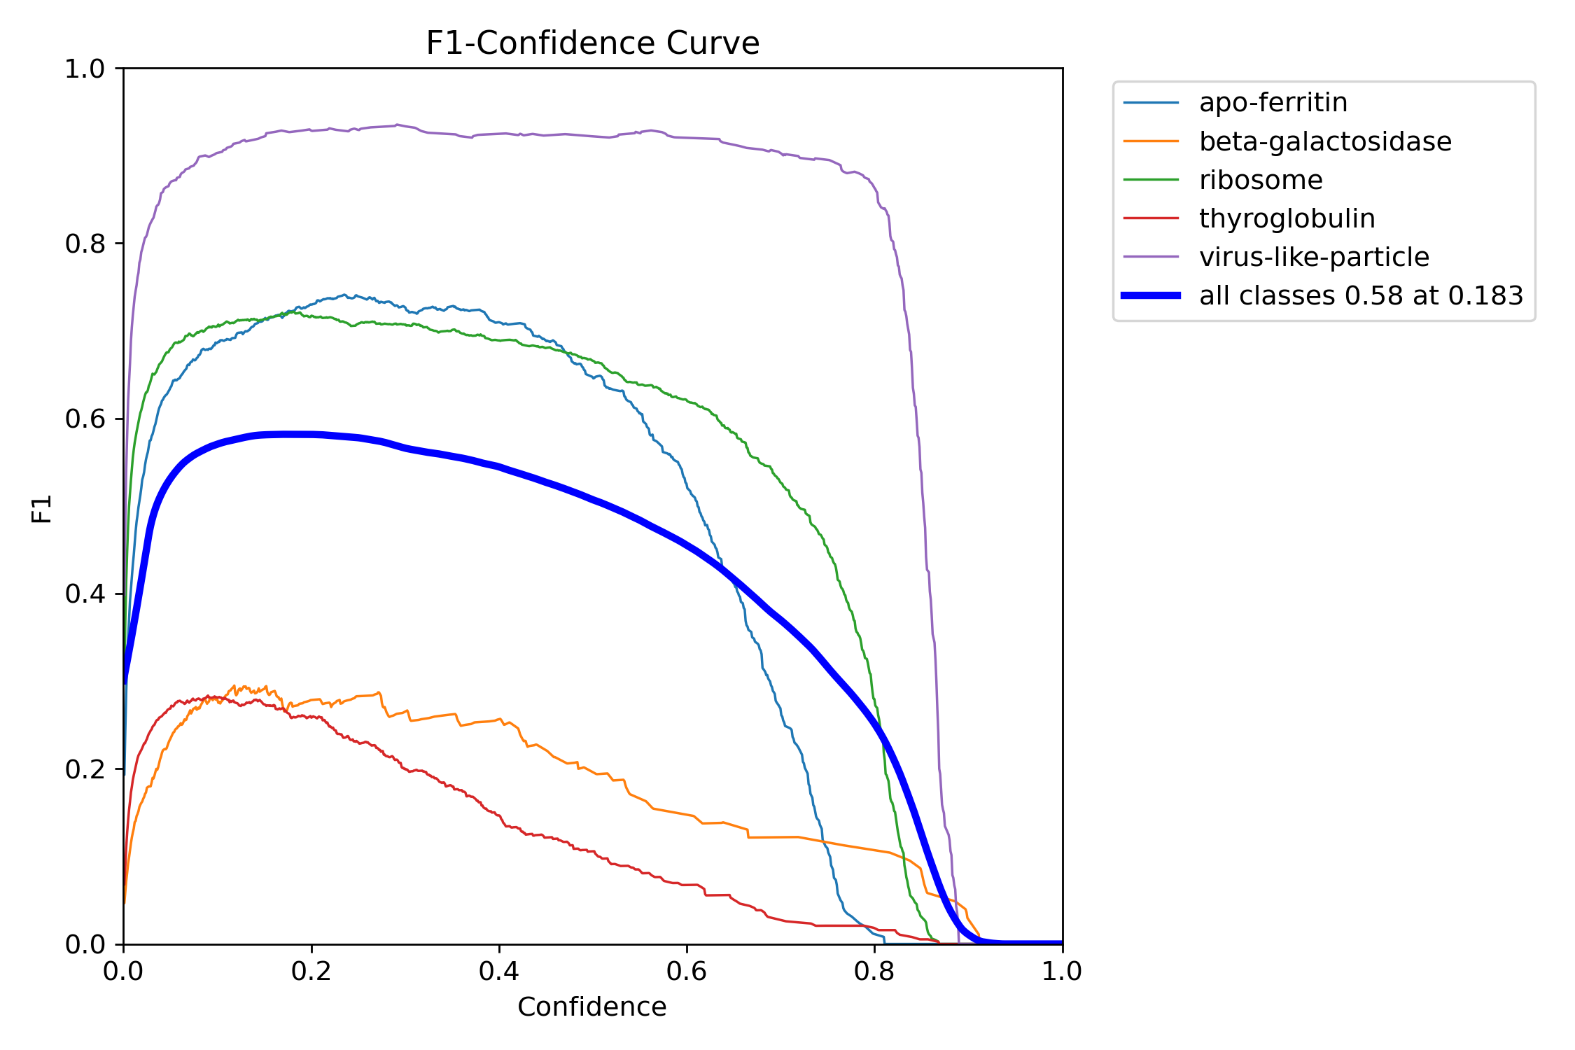
Train the model results

Slide 8
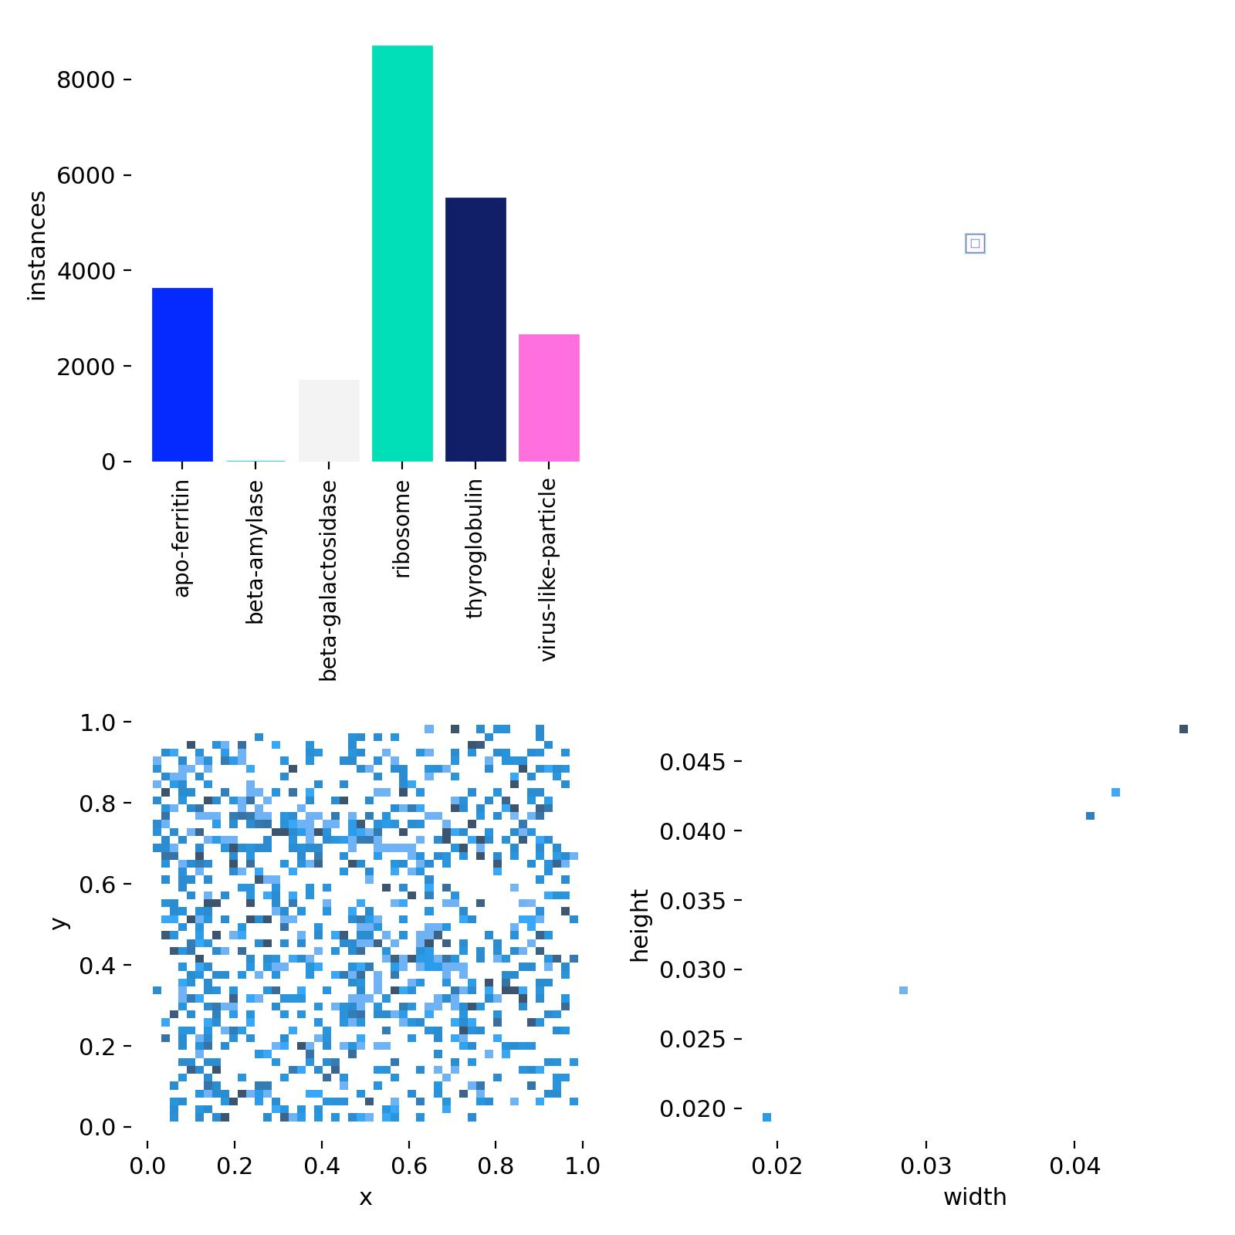
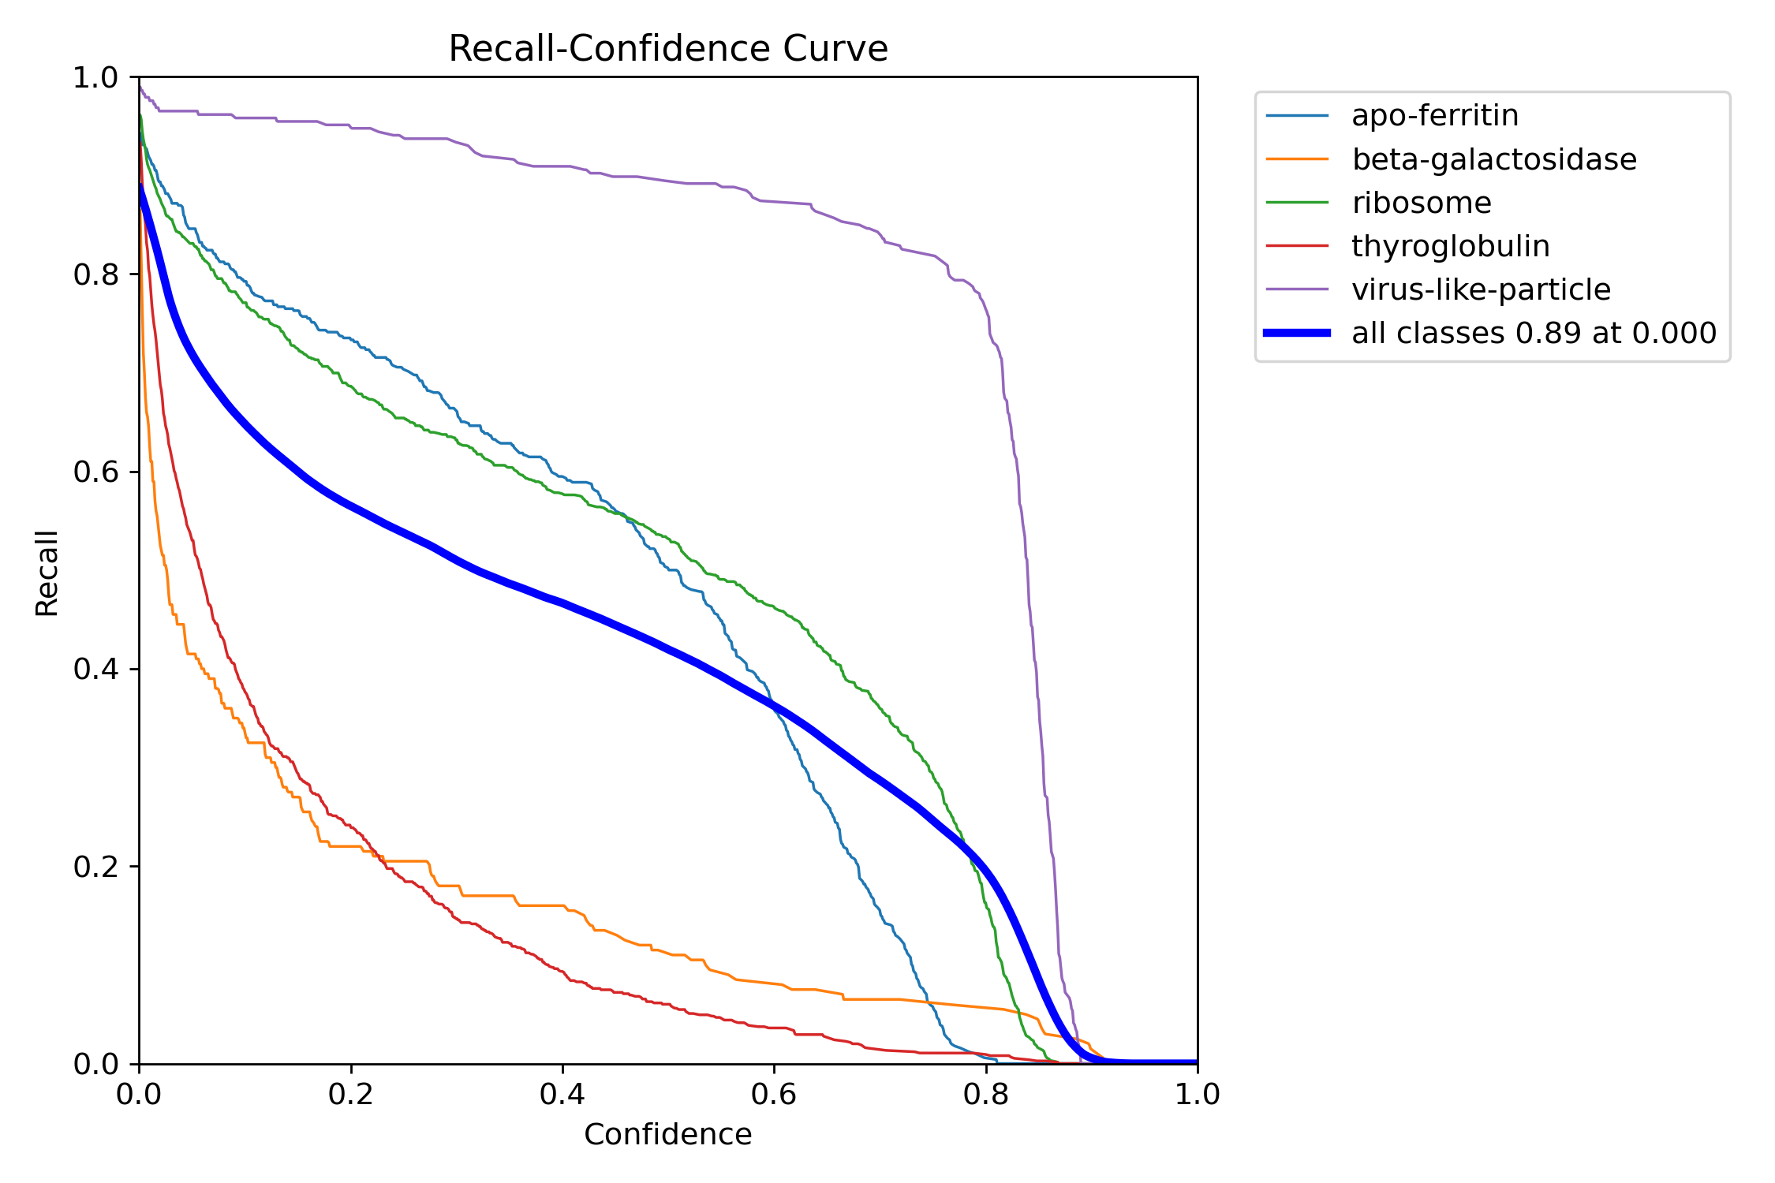
Train the model labels results

Slide 9
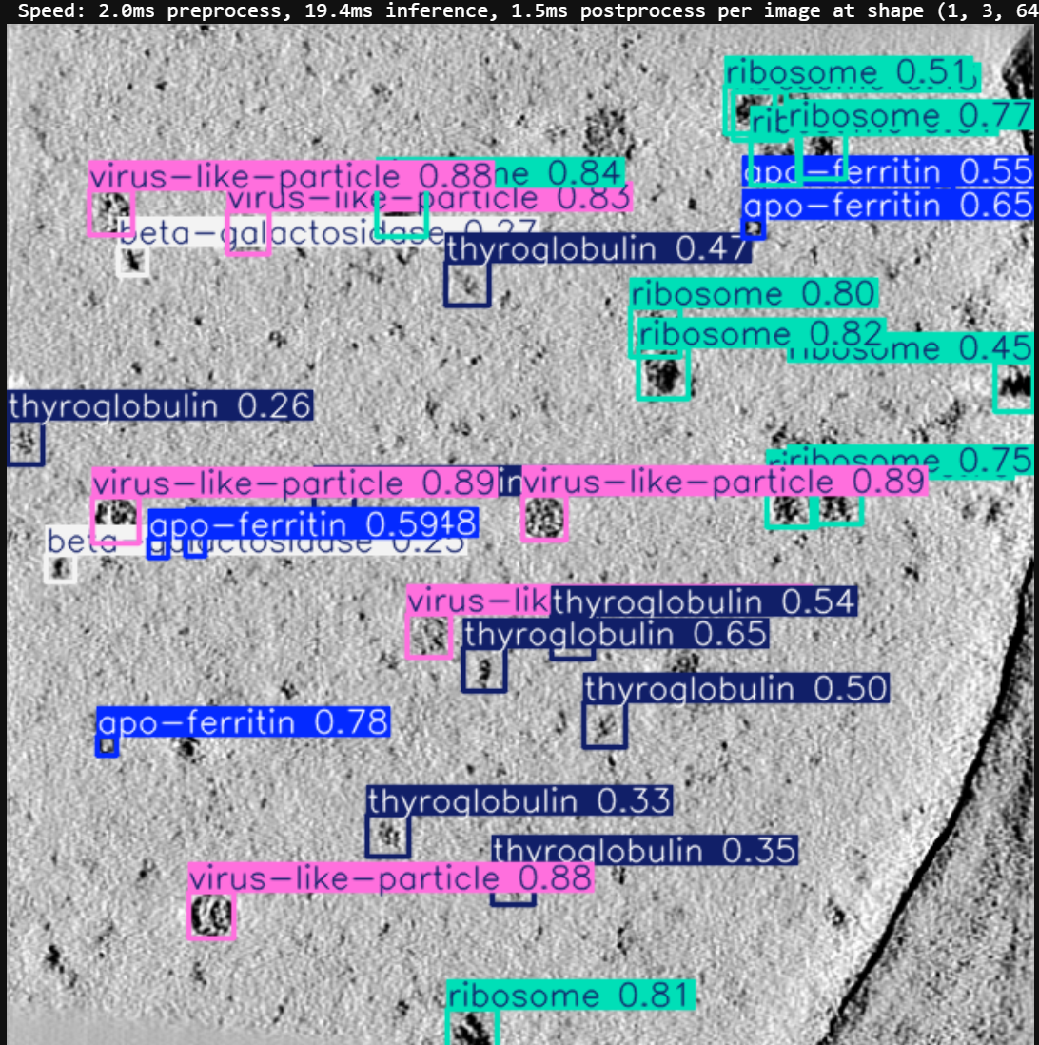
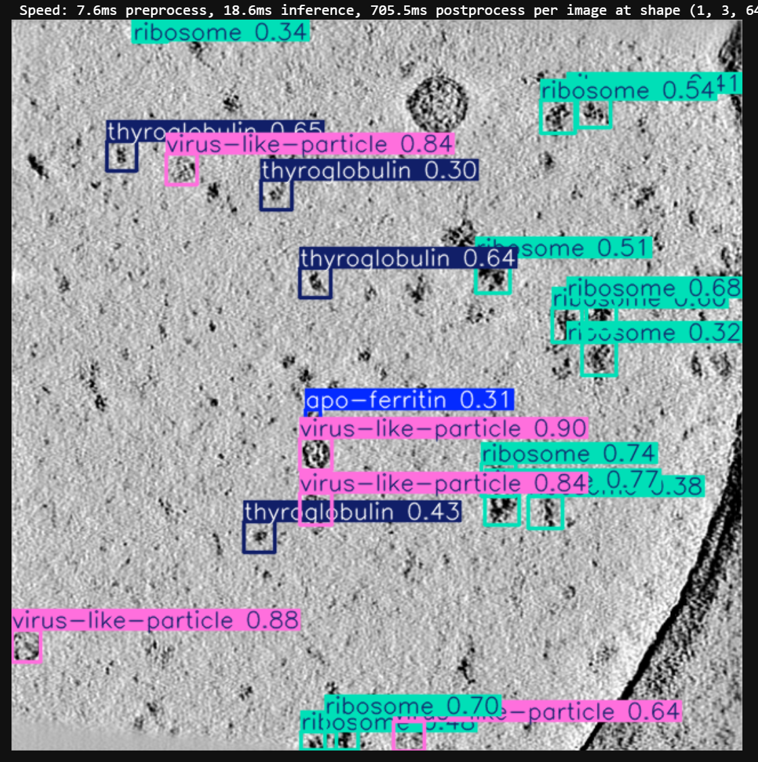
Predicted labels from Validation data

Slide 10
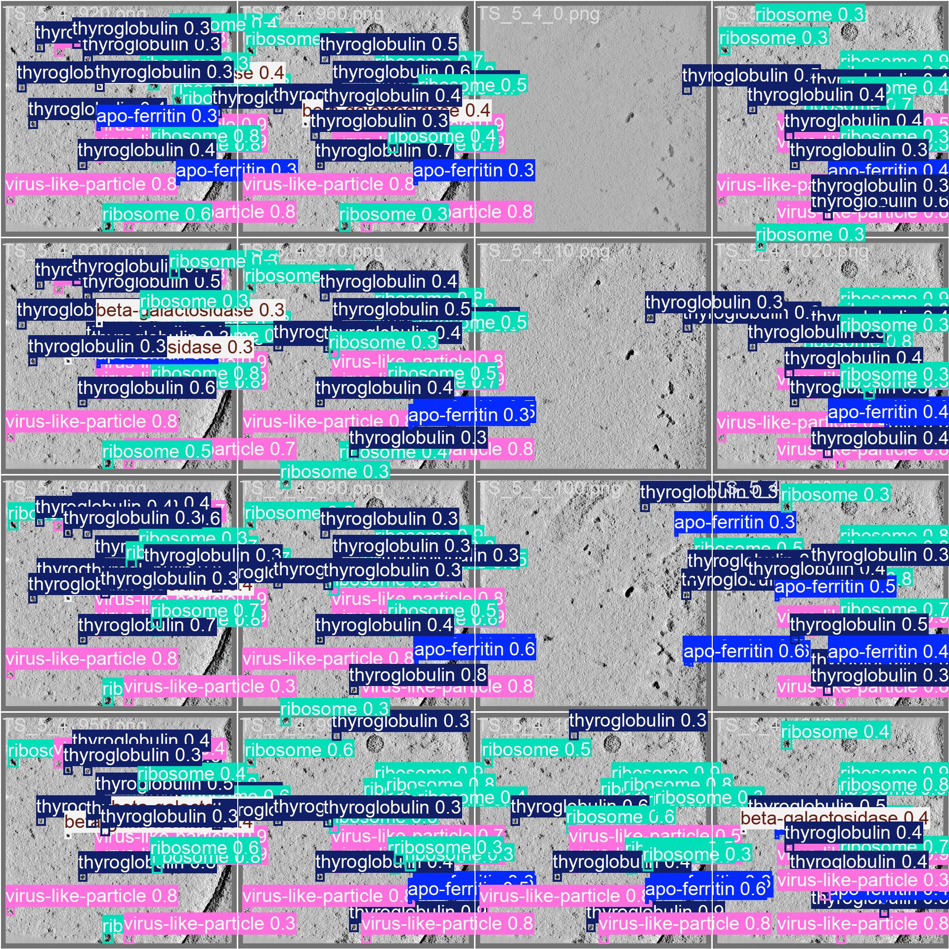
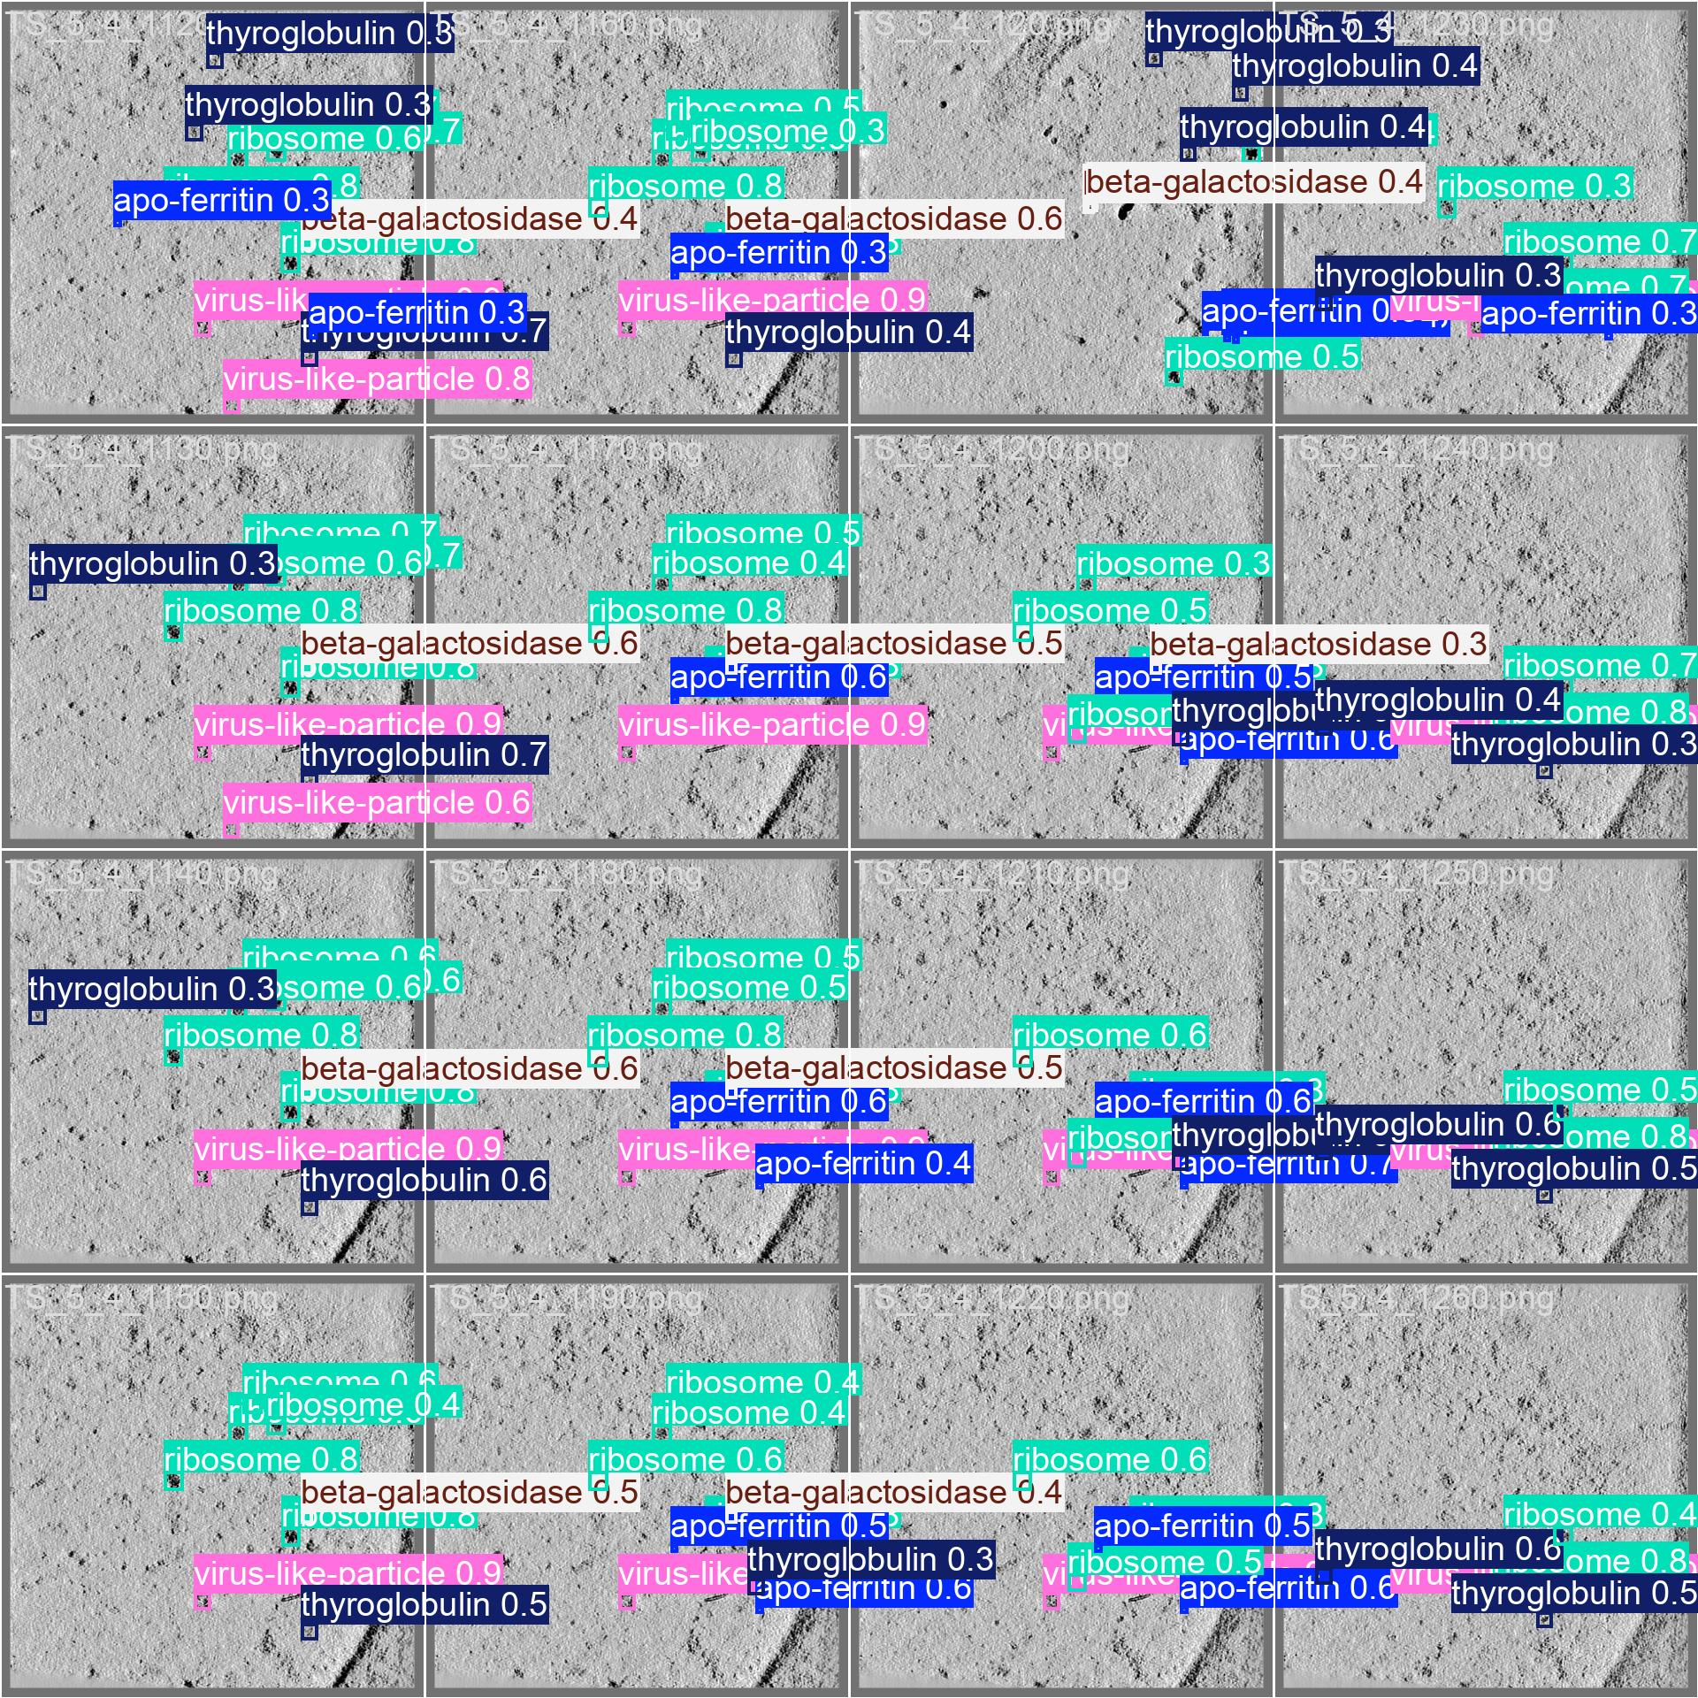
Predicted labels from Validation data

Slide 11

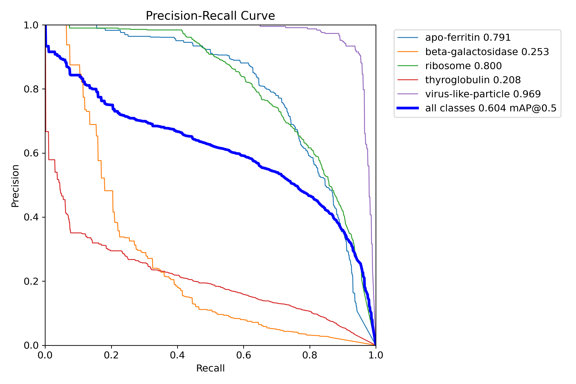
Conclusion
Conclusion and Takeaways YOLO Model :
Overall Model Performance:
Precision: The model shows a balanced precision (around 0.59), indicating a reasonable level of confidence in the predicted positive instances.
Recall: Recall (around 0.574) signifies the model's ability to capture true positive instances, though there is room for improvement.
mAP@50 and mAP@50-95: These metrics (0.604 and 0.441, respectively) suggest the model performs well on average, but further fine-tuning could enhance its performance.
Class-Specific Insights:
apo-ferritin: High precision and recall indicate the model is well-tuned for this class.
beta-galactosidase: Lower recall and precision highlight the need for more targeted data augmentation and possibly increased data representation.
ribosome: High precision and recall show effective learning for this class.
thyroglobulin: Similar to beta-galactosidase, it needs further focus to improve its metrics.
virus-like-particle: Excellent performance across the board demonstrates strong model generalization for this class.

